Slide 1
Phylum
Mollusca
(5 Classes)
Polyplacophora – Many plates on a foot Cephalopoda – Head foot
Gastropoda – Stomach
Scaphopoda – Tusk shell
Bivalvia – Hatchet foot
foot
Policemen Censor Gals in Scant Bikinis!

Slide 2
Typical questions for Mollusca
How many of these specimens posses a radula?
Which ones are filter feeders?
Which have undergone torsion? Detorsion?
Name the main function of the mantle?
Name a class used for currency
Which specimens have lungs?
(Just have think of which live on land vs. in water……)
Name the oldest part of a univalve shell? Bivalve?

Slide 3
Answers…maybe
Gastropods, Cephalopoda, Mono-, A- & Polyplacophora
Bivalvia (Scaphopoda….have a captacula)
Gastropods Opisthobranchia (sea hares & sea slugs) and the land slugs of the Pulmonata
Mantle secretes the shell
Scaphopoda
Pulmonata – their name gives this away
Apex for Univalve, Umbo for bivalve but often the terms are used interchangeably

Slide 4
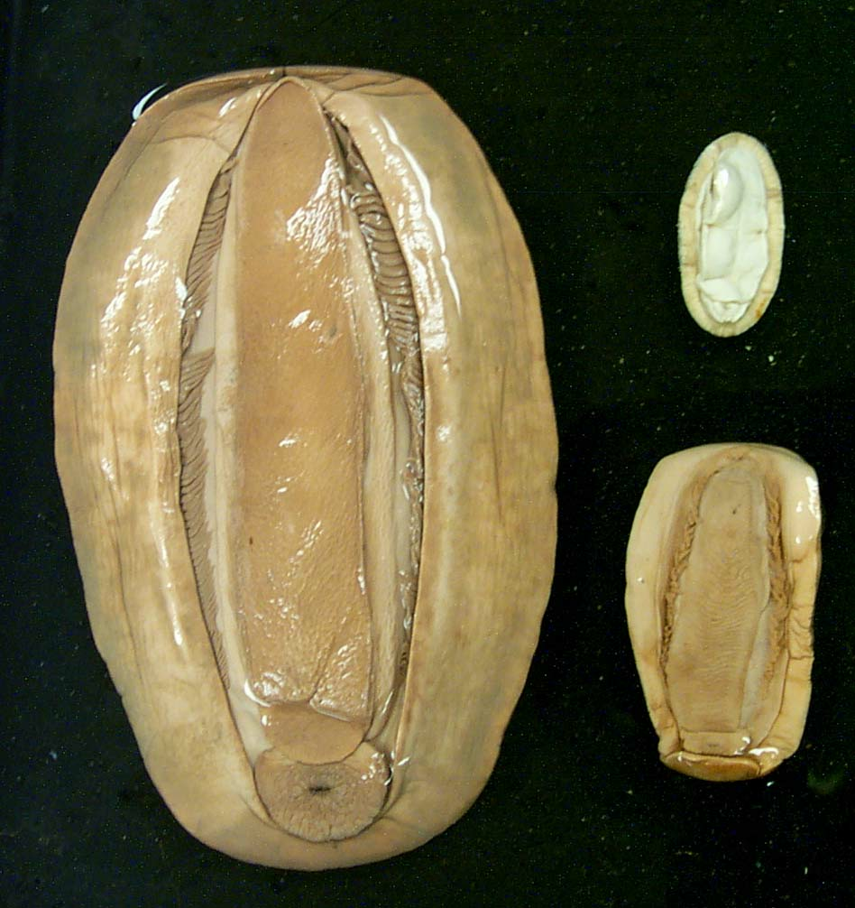
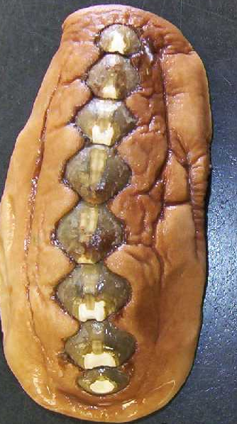
Anus
Gills in mantle cavity
Mantle
Radula in mouth
Head
Chitons radula, 8 plates
Class Polyplacophora

Slide 5
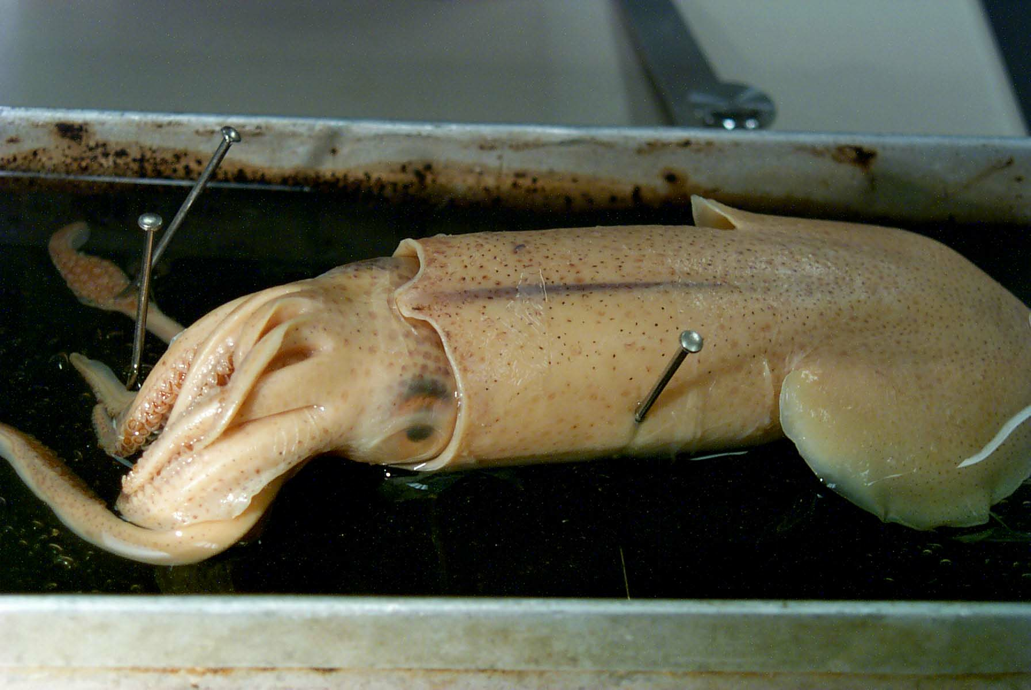
Tentacles (2) & arms are all derived from the gastropod foot
Class Cephalopoda - Octopuses, Squid, Nautilus,
Cuttlefish…beak, pen, ink sac, chromatophores,
jet propulsion……….dissection.

Slide 6
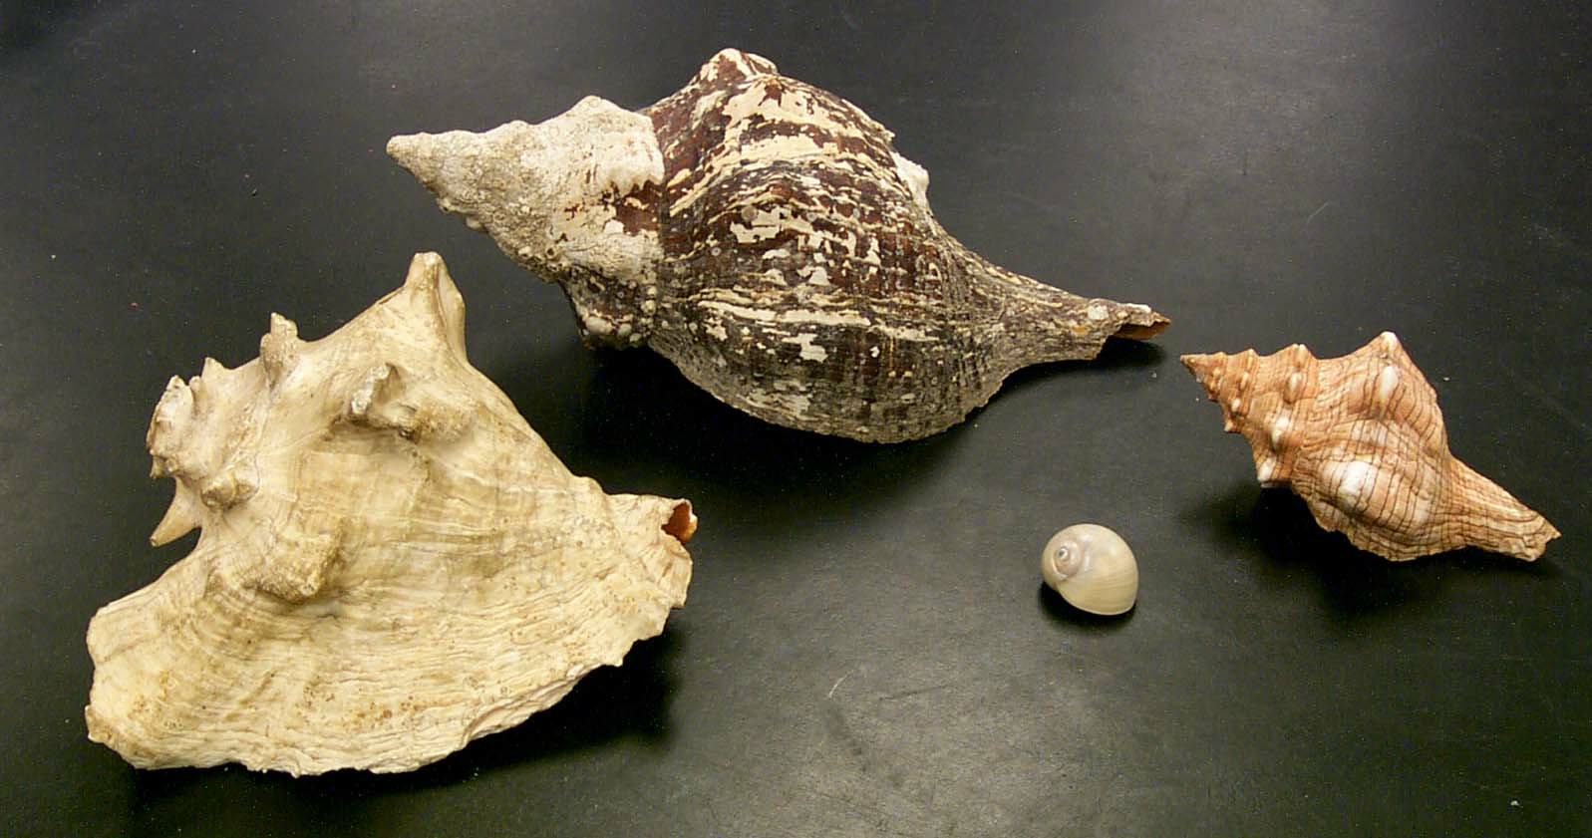
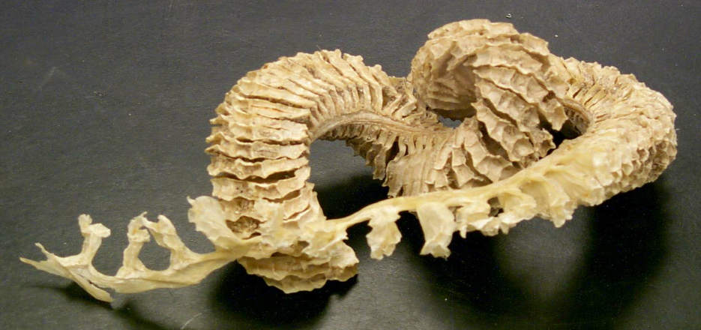
Aquatic – marine.
Generally having thick pointed shells, spines, & many have opercula.
Subclass Prosobranchia
Apex
Gastropoda
WORDS TO KNOW:
snails, conchs,
torsion, coiling,
radula,
operculum &
egg sac
Subclass Pulmonata
Aquatic – freshwater.
Shells are thin, rounded, with no spines, ridges or opercula.

Slide 7
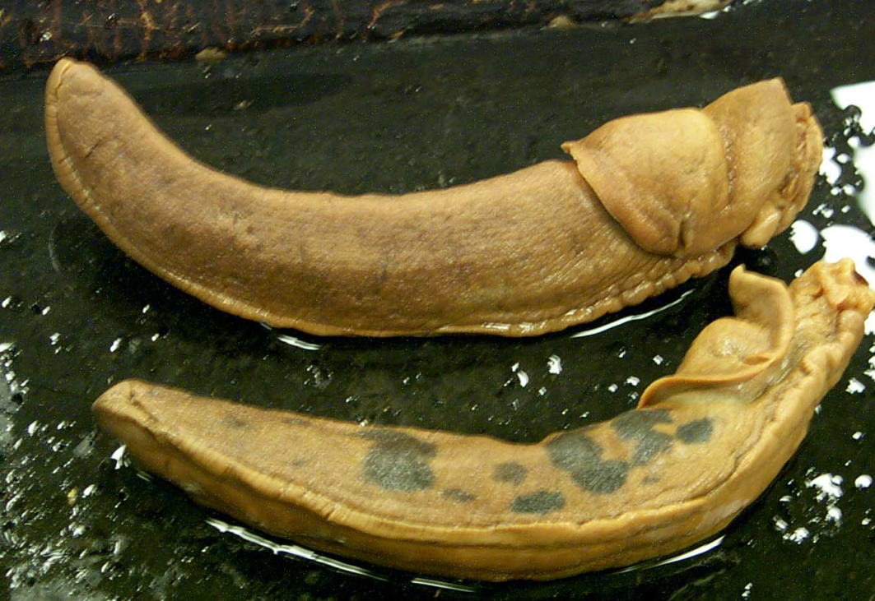
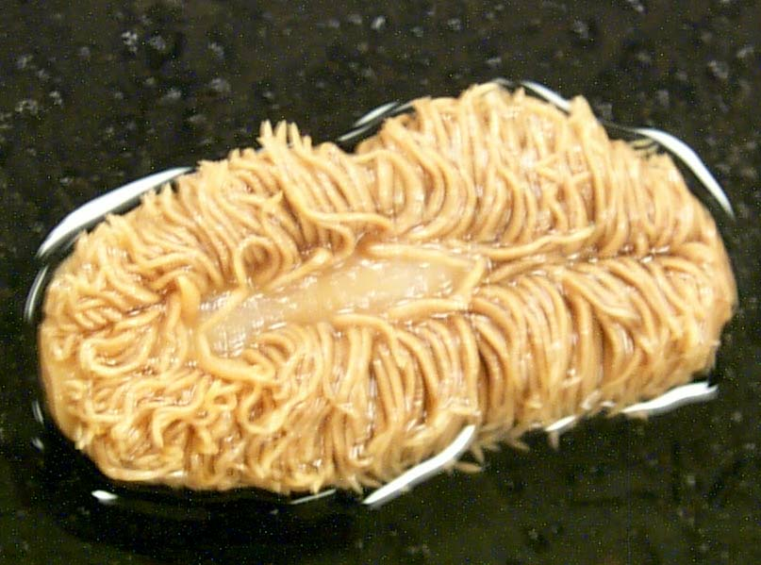
Subclass Pulmonata
Slug
Detorsion…
If something looks strange, chances are….
…….it is
something from Class Gastropoda
(…or your roommate!)
Subclass Opisthobranchia
Nudibranch

Slide 8
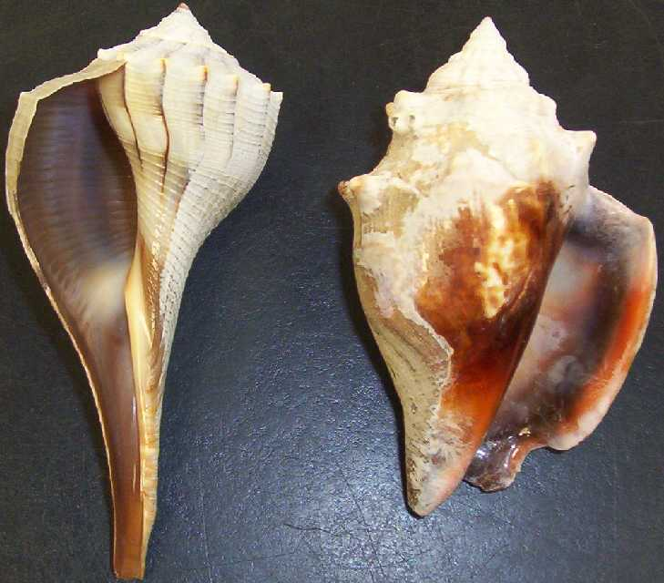

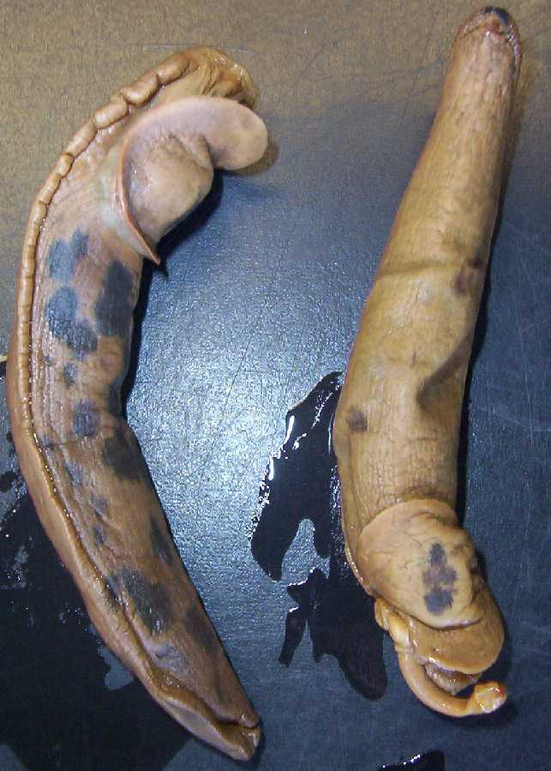
Class Gastropoda
‘POP’
Sinistral
Dextral
Subclass Prosobranchia
- Aquatic snails (“shells”)
- Have gills
Subclass Opisthobranchia
    Marine
    Have gills
- Nudibranchs / Sea slugs / Sea hares
    Mantle cavity & shell reduced or absent
Subclass Pulmonata
    Terrestrial Slugs and terrestrial snails
    Have lungs

Slide 9
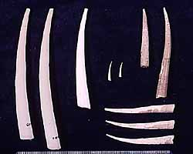
Class Scaphopoda - “tusk shells”
Wampum Indian currency. ‘Head’ in sand. Respire through mantle (no gills.) Captacula for feeding on (capturing) foramniferans

Slide 10
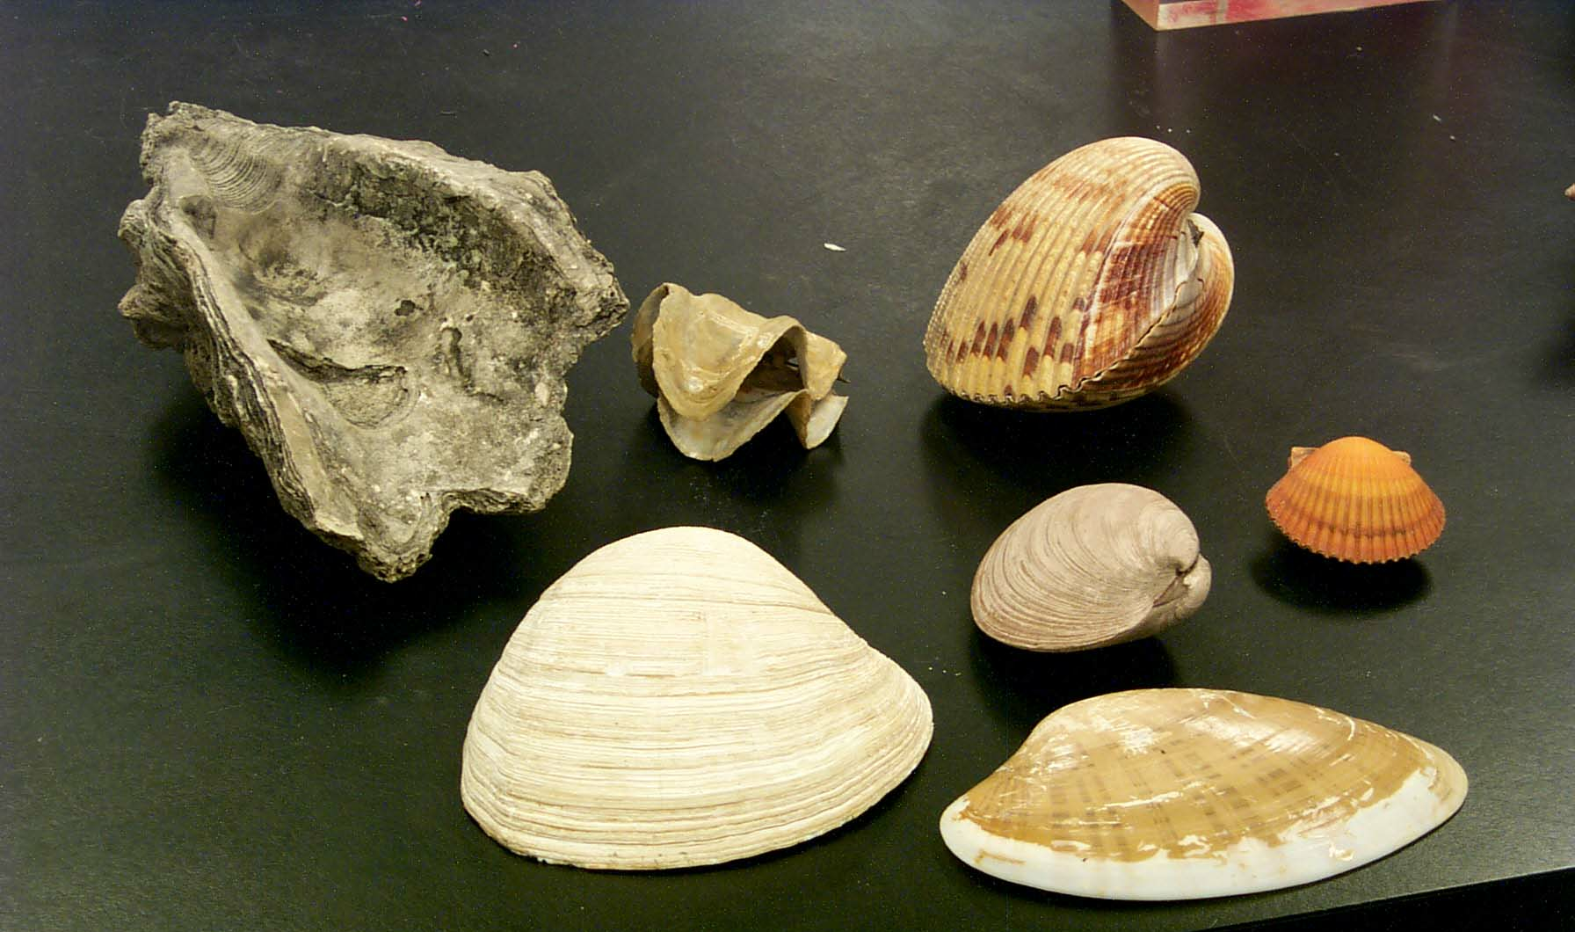
Name of oldest part?
D
P
A
V
ClaBivalvia or Pelecypoda - clams, scallops etc.
filter feeders, bivalved shells…… dissection

Slide 11
Umbo
D
P
A
V
ClaBivalvia or Pelecypoda - clams, scallops etc.
filter feeders, bivalved shells…… dissection

Slide 12
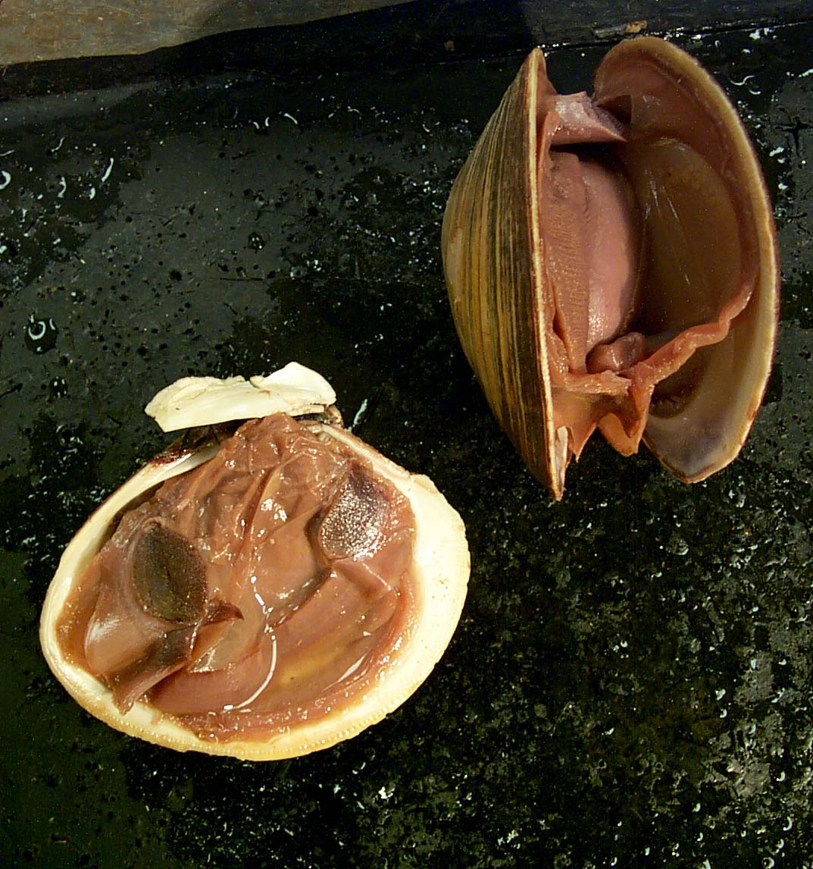
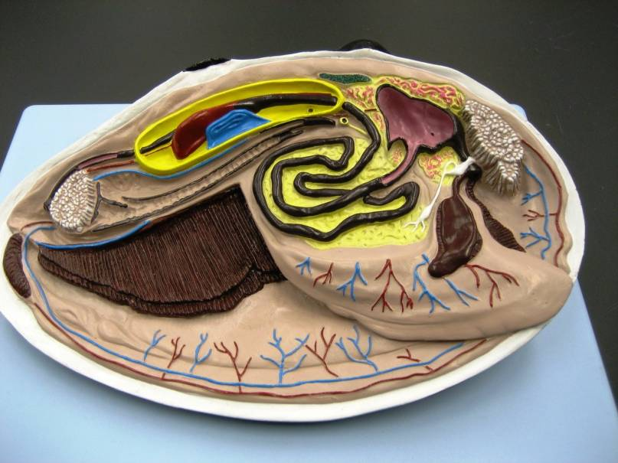

Slide 13
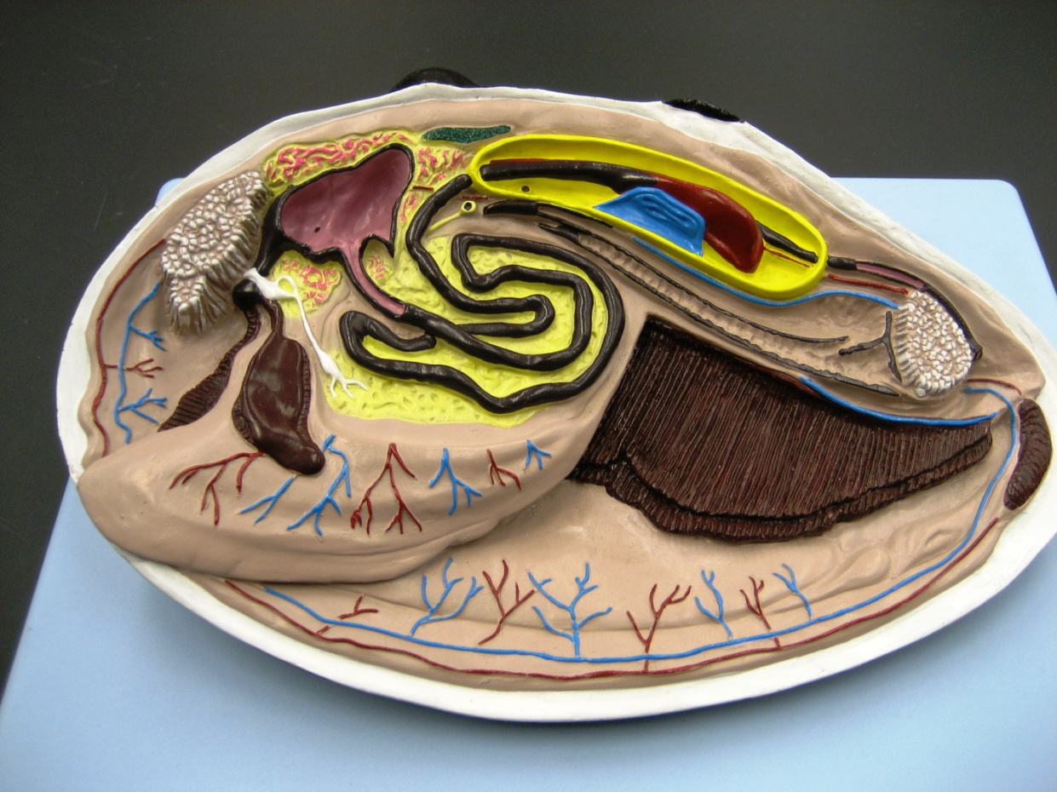
Dorsal (hinge)
Visceral mass – gonads & digestive tissues
Percardial cavity
Ventricle
Anterior (Umbo)
Intestine
Auricle
Adductor
muscle
Stomach = Area of gastric & /digestive glands
Mouth
Labial palps
Posterior
Visceral Mass
Excurrent
& Incurrent siphon
(-hairs & papullae)
Gills or ctenidium –
Each = 2 demibranchs
Foot
Mantle
Foot
Ventral
Mantle

Slide 14
Quiz Mollusca
How many classes posses a radula?
  3 of the 5 classes (Cephalopoda, Polyplacophora & Gastropoda)
How many are filter feeders?
  1 of the 5 classes (Bivalvia)
What feeding structure do Scaphopoda use?
  A/ pedicellaria B/captacula or C/Aristotle’s Lantern?
  – B - to catch foramnifera

